Slide 1

Markov Chains: Case Study
MTH 564 – Mathematical Modeling

Slide 2
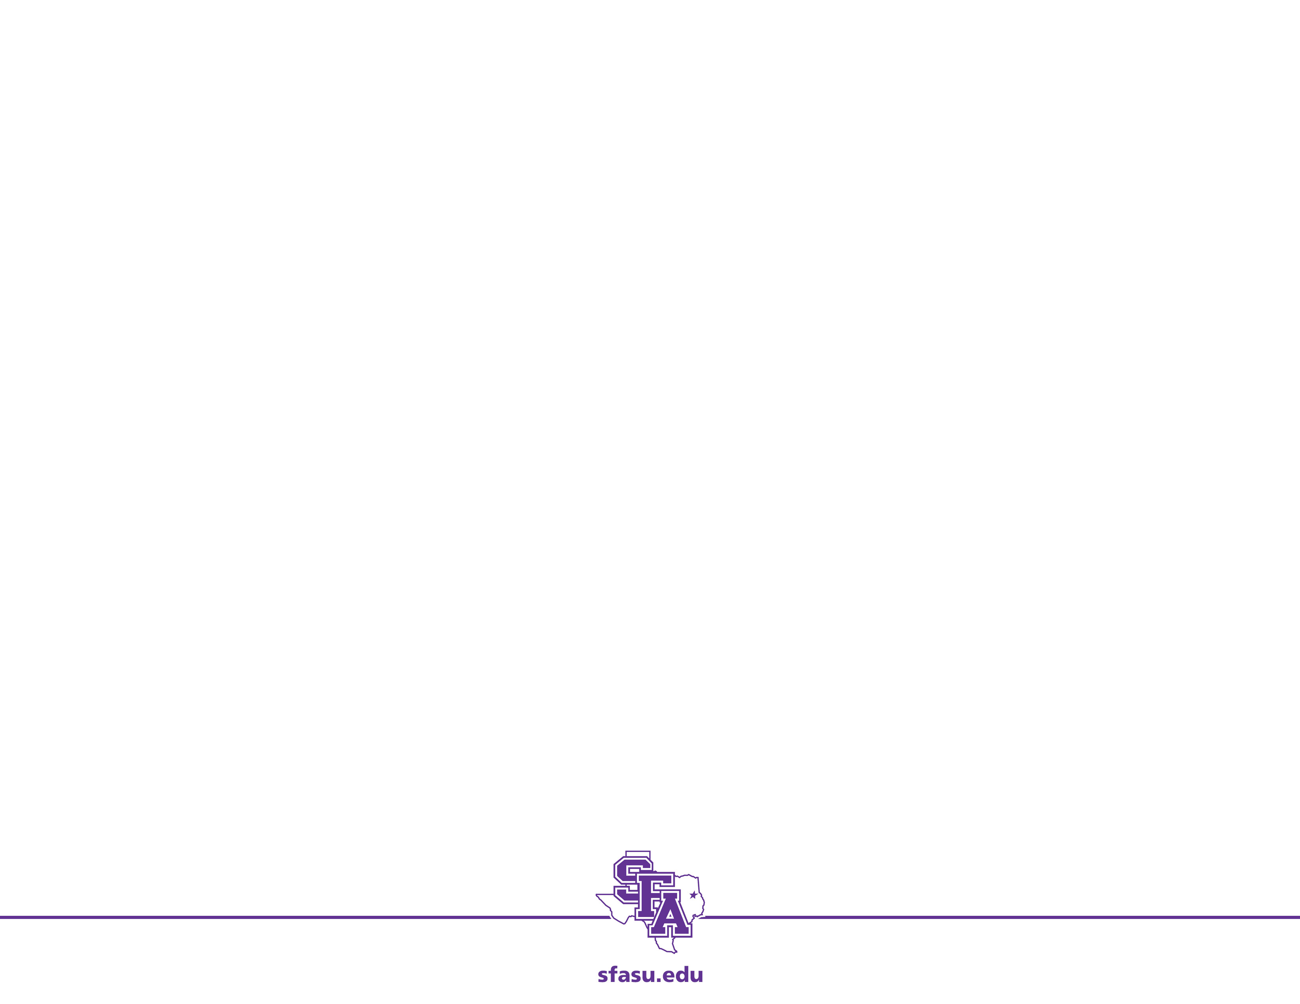
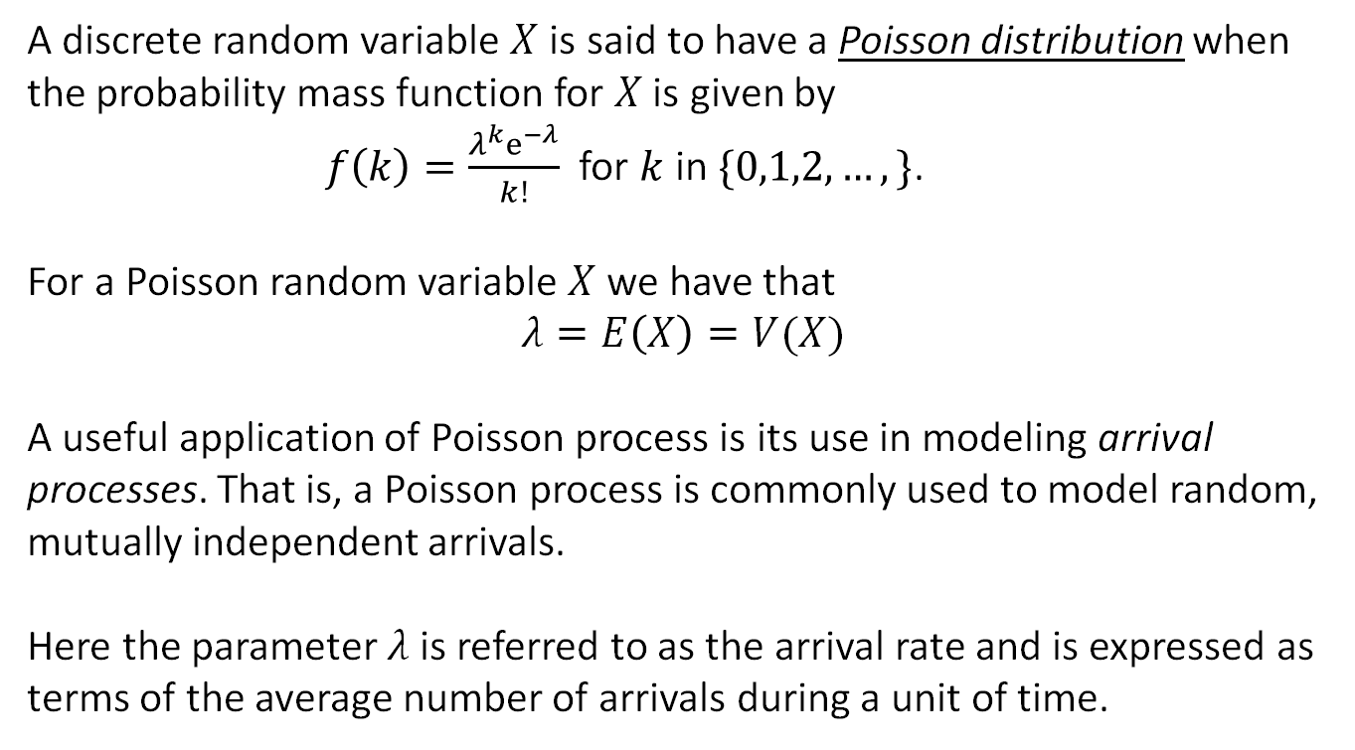
Poisson Distribution: Review
A discrete random variable $X$is said to have a Poisson distribution when the probability mass function for $X$ is given by
$f\left(k\right)=\frac{λ^{k}e^{−λ}}{k!}$ for $k$ in $\{0,1,2,…,\}$.
For a Poisson random variable $X$ we have that
$$λ=E\left(X\right)=V(X)$$
A useful application of Poisson process is its use in modeling arrival processes. That is, a Poisson process is commonly used to model random, mutually independent arrivals.
Here the parameter $λ$ is referred to as the arrival rate and is expressed as terms of the average number of arrivals during a unit of time.

Slide 3
Problem
A pet store sells a limited number of 20-gallon aquariums. At the end of each week, the store manager takes inventory and places orders. Store policy is to order three new 20-gallon aquariums at the end of the week if all of the current inventory has been sold. If even one of the 20-gallon aquariums remain in stock, no new units are ordered. This policy is based on the observation that the store only sells an average of one of the 20-gallon aquariums per week. Is this policy adequate to guard potential lost sales of 20-gallon aquariums due to a customer requesting one when they are out of stock?

Slide 4
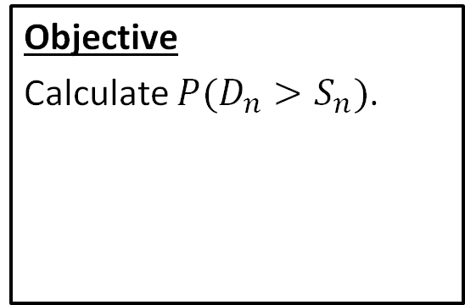
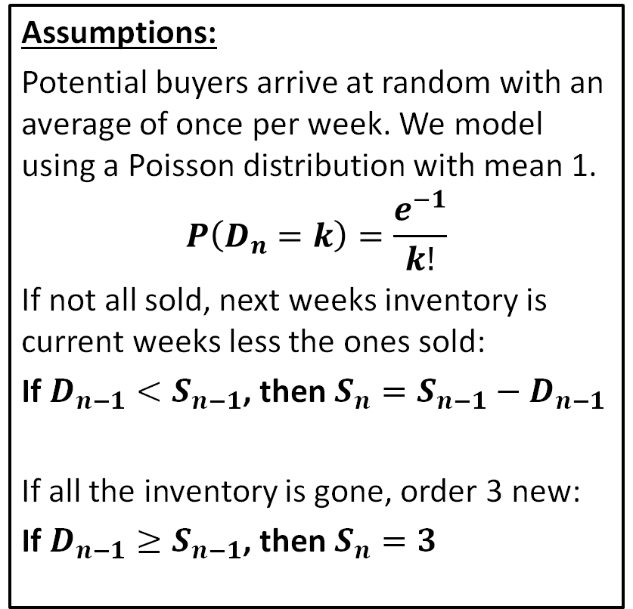
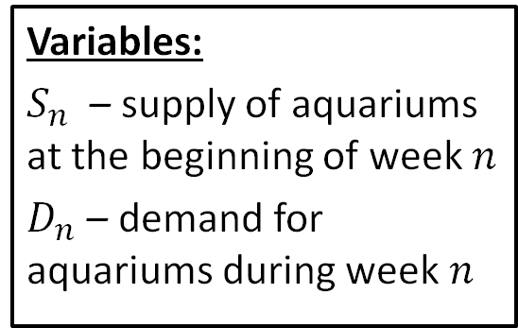
Step 1: Frame the problem
Variables:
$S_{n}$ – supply of aquariums at the beginning of week $n$
$D_{n}$ – demand for aquariums during week $n$
Assumptions:
Potential buyers arrive at random with an average of once per week. We model using a Poisson distribution with mean 1.
$$P\left(D_{n}=k\right)=\frac{e^{−1}}{k!}$$
If not all sold, next weeks inventory is current weeks less the ones sold:
If $D_{n−1}<S_{n−1}$, then $S_{n}=S_{n−1}−D_{n−1}$
If all the inventory is gone, order 3 new:
If $D_{n−1}≥S_{n−1}$, then $S_{n}=3$
Objective
Calculate $P(D_{n}>S_{n})$.

Slide 5
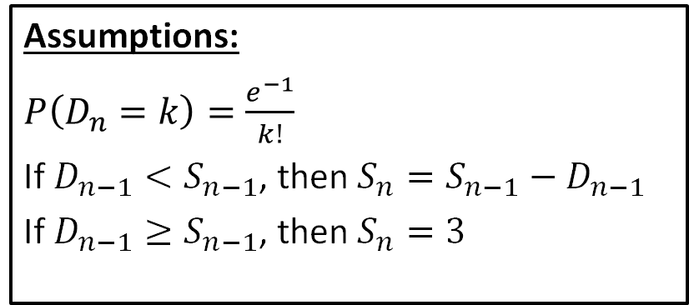
Step 2: Select the modeling approach
Variables:
$S_{n}$ – supply of aquariums at the beginning of week $n$
$D_{n}$ – demand for aquariums during week $n$
Assumptions:
$P\left(D_{n}=k\right)=\frac{e^{−1}}{k!}$
If $D_{n−1}<S_{n−1}$, then $S_{n}=S_{n−1}−D_{n−1}$
If $D_{n−1}≥S_{n−1}$, then $S_{n}=3$
Objective
Calculate $P(D_{n}>S_{n})$.
Modeling Approach
We use a Markov chain model.

Slide 6
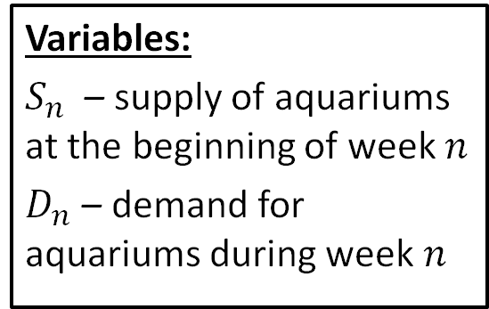
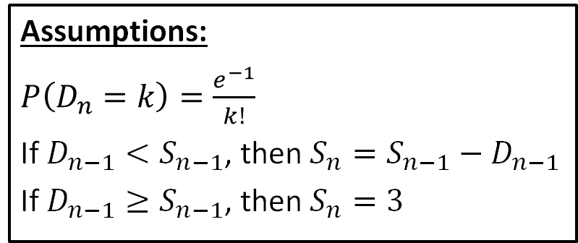
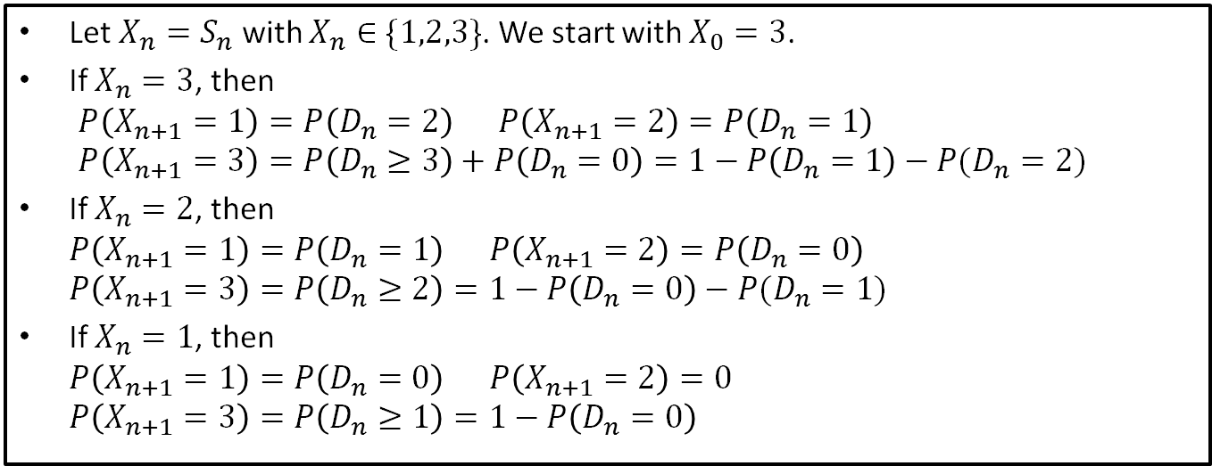
Step 3: Formulate the model
Assumptions:
$P\left(D_{n}=k\right)=\frac{e^{−1}}{k!}$
If $D_{n−1}<S_{n−1}$, then $S_{n}=S_{n−1}−D_{n−1}$
If $D_{n−1}≥S_{n−1}$, then $S_{n}=3$
Variables:
$S_{n}$ – supply of aquariums at the beginning of week $n$
$D_{n}$ – demand for aquariums during week $n$
Let $X_{n}=S_{n}$ with $X_{n}∈\{1,2,3\}$. We start with $X_{0}=3$.
If $X_{n}=3$, then $P\left(X_{n+1}=1\right)=P\left(D_{n}=2\right) P\left(X_{n+1}=2\right)=P\left(D_{n}=1\right)$ $P\left(X_{n+1}=3\right)=P\left(D_{n}≥3\right)+P\left(D_{n}=0\right)=1−P\left(D_{n}=1\right)−P(D_{n}=2)$
If $X_{n}=2$, then $P\left(X_{n+1}=1\right)=P\left(D_{n}=1\right) P\left(X_{n+1}=2\right)=P\left(D_{n}=0\right)$ $P\left(X_{n+1}=3\right)=P\left(D_{n}≥2\right)=1−P\left(D_{n}=0\right)−P(D_{n}=1)$
If $X_{n}=1$, then $P\left(X_{n+1}=1\right)=P\left(D_{n}=0\right) P\left(X_{n+1}=2\right)=0$ $P\left(X_{n+1}=3\right)=P\left(D_{n}≥1\right)=1−P\left(D_{n}=0\right)$

Slide 7
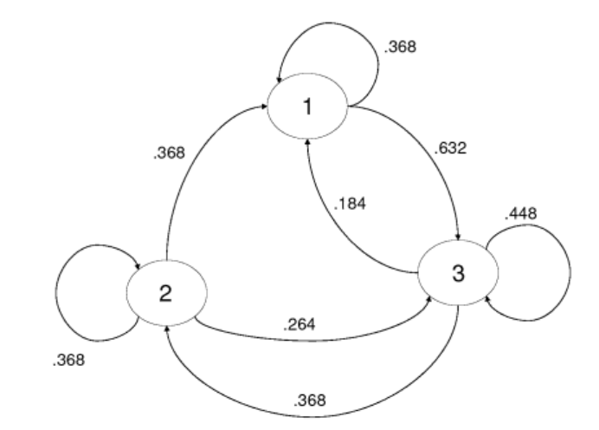
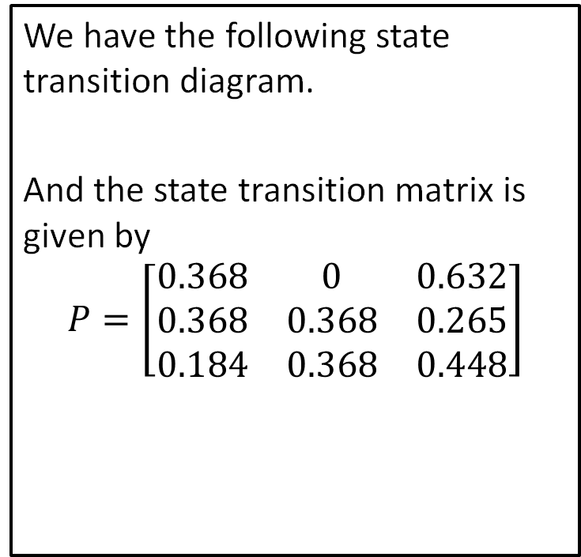
Step 3: Formulate the model
We have the following state transition diagram.
And the state transition matrix is given by
$$P=\left[\begin{matrix}0.368 & 0 & 0.632 \\ 0.368 & 0.368 & 0.265 \\ 0.184 & 0.368 & 0.448\end{matrix}\right]$$

Slide 8
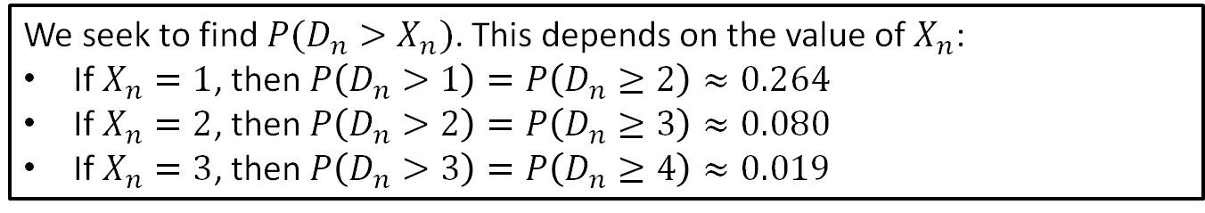
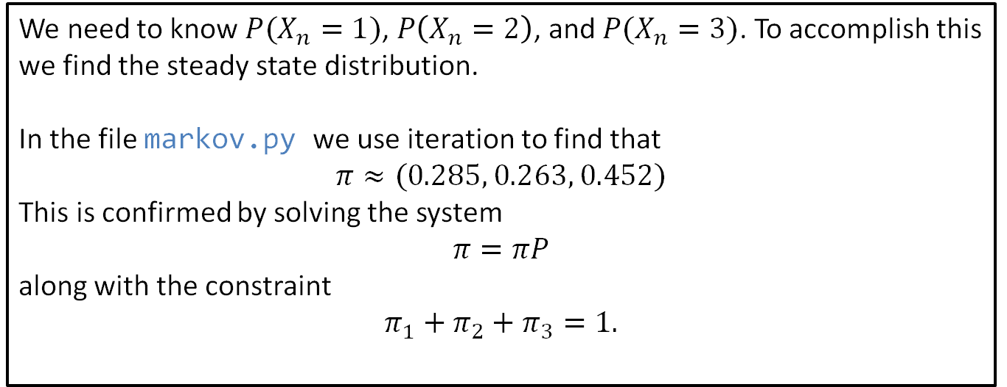
Step 4: Solve the Problem
We seek to find $P(D_{n}>X_{n})$. This depends on the value of $X_{n}$:
If $X_{n}=1$, then $P\left(D_{n}>1\right)=P\left(D_{n}≥2\right)≈0.264$
If $X_{n}=2$, then $P\left(D_{n}>2\right)=P\left(D_{n}≥3\right)≈0.080$
If $X_{n}=3$, then $P\left(D_{n}>3\right)=P\left(D_{n}≥4\right)≈0.019$
We need to know $P(X_{n}=1)$, $P\left(X_{n}=2\right)$, and $P(X_{n}=3)$. To accomplish this we find the steady state distribution.
In the file markov.py we use iteration to find that
$$π≈(0.285, 0.263, 0.452)$$
This is confirmed by solving the system
$$π=πP$$
along with the constraint
$$π_{1}+π_{2}+π_{3}=1.$$
Notes:
See python file section1-1pig.py

Slide 9
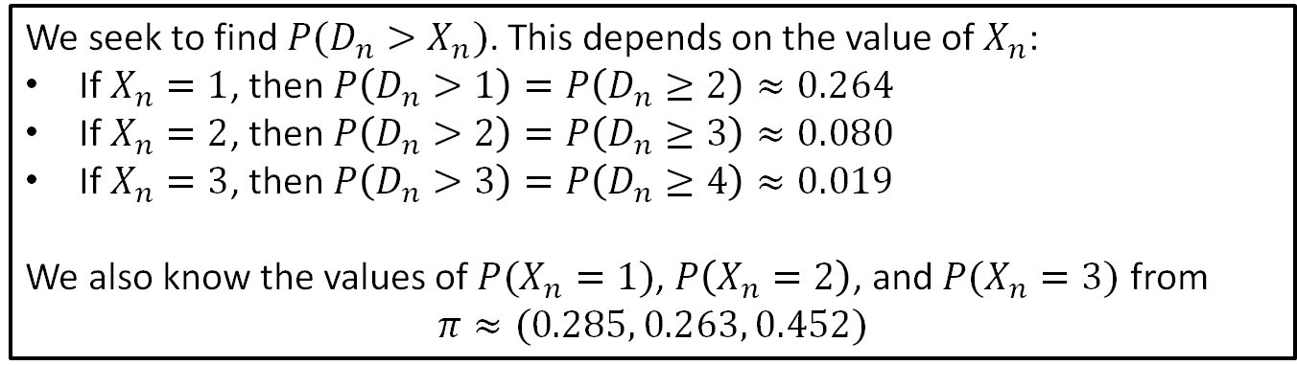
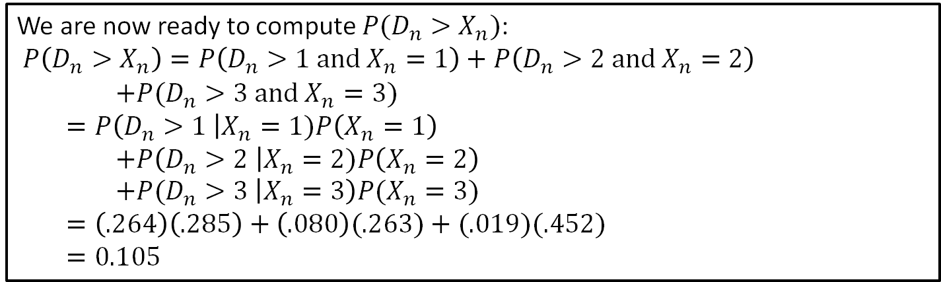
Step 4: Solve the Problem
We seek to find $P(D_{n}>X_{n})$. This depends on the value of $X_{n}$:
If $X_{n}=1$, then $P\left(D_{n}>1\right)=P\left(D_{n}≥2\right)≈0.264$
If $X_{n}=2$, then $P\left(D_{n}>2\right)=P\left(D_{n}≥3\right)≈0.080$
If $X_{n}=3$, then $P\left(D_{n}>3\right)=P\left(D_{n}≥4\right)≈0.019$
We also know the values of $P(X_{n}=1)$, $P\left(X_{n}=2\right)$, and $P(X_{n}=3)$ from
$$π≈(0.285, 0.263, 0.452)$$
We are now ready to compute $P(D_{n}>X_{n})$:
$P\left(D_{n}>X_{n}\right)=P\left(D_{n}>1 and X_{n}=1\right)+P\left(D_{n}>2 and X_{n}=2\right)$ $+P(D_{n}>3 and X_{n}=3)$ $=P\left(D_{n}>1 \right|X_{n}=1)P\left(X_{n}=1\right)$ $+P\left(D_{n}>2 \right|X_{n}=2)P\left(X_{n}=2\right)$ $+P(D_{n}>3 \left|X_{n}=3\right)P(X_{n}=3)$
$=\left(.264\right)\left(.285\right)+\left(.080\right)(.263)+(.019)(.452)$
$=0.105$
Notes:
See python file section1-1pig.py

Slide 10
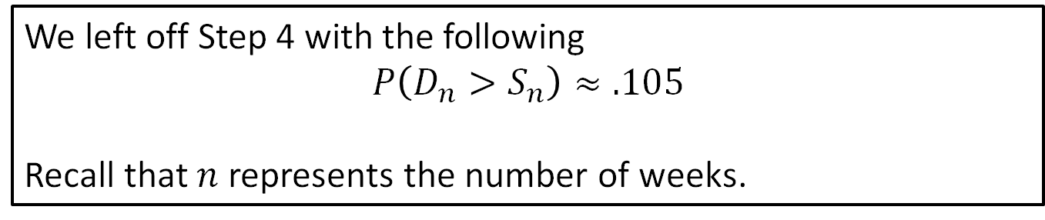
Step 5: Answer the question
We left off Step 4 with the following
$$P\left(D_{n}>S_{n}\right)≈.105$$
Recall that $n$ represents the number of weeks.
The store policy will result in lost sales roughly 10.5% of the time. Using 52 in a year, we have that the store will experience a lost sale in 5 or 6 weeks of a given year.
Although we only sell an average of 1 aquarium per week, the demand fluctuates. For weeks that we only have one unit in stock, we run a risk of losing sales due to insufficient inventory. It may be advisable to adjust the policy so that we never start a week with only one aquarium in stock.
Notes:
See python file section1-1pig.py

Slide 11
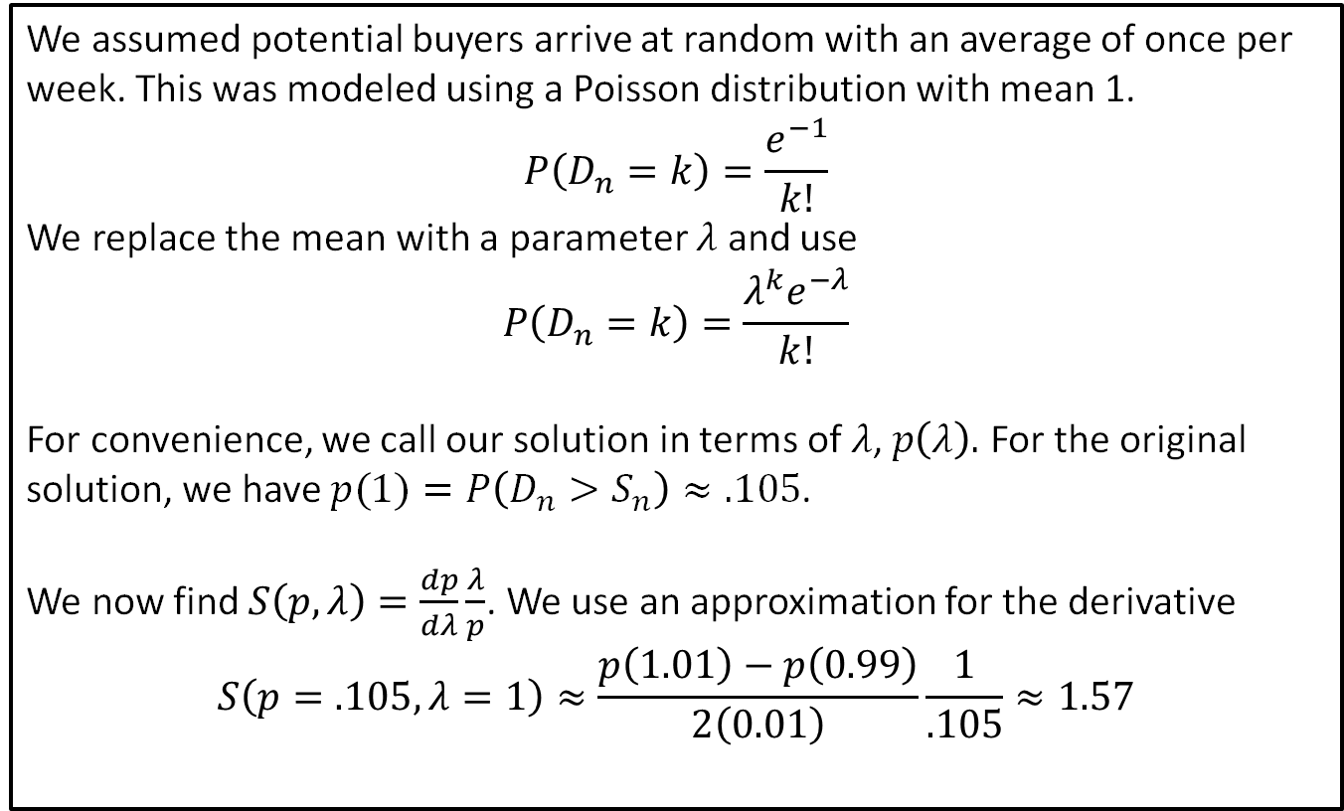
Sensitivity Analysis: Mean
We assumed potential buyers arrive at random with an average of once per week. This was modeled using a Poisson distribution with mean 1.
$$P\left(D_{n}=k\right)=\frac{e^{−1}}{k!}$$
We replace the mean with a parameter $λ$ and use
$$P\left(D_{n}=k\right)=\frac{{λ^{k}e}^{−λ}}{k!}$$
For convenience, we call our solution in terms of $λ$, $p\left(λ\right).$ For the original solution, we have $p(1)=P\left(D_{n}>S_{n}\right)≈.105$.
We now find $S\left(p, λ\right)=\frac{dp}{dλ}\frac{λ}{p}$. We use an approximation for the derivative
$$S\left(p=.105,λ=1\right)≈\frac{p\left(1.01\right)−p\left(0.99\right)}{2\left(0.01\right)}\frac{1}{.105}≈1.57$$
Notes:
See python file section1-1pig.py

Slide 12
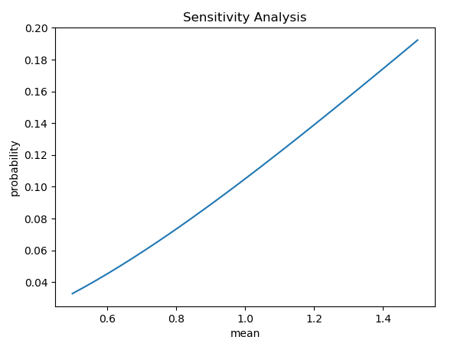
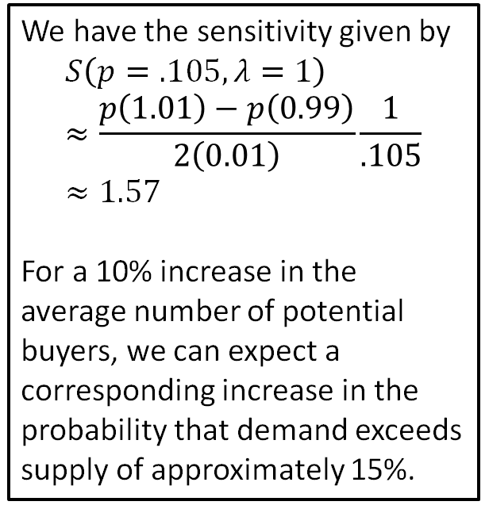
Sensitivity Analysis: Mean
We have the sensitivity given by
$$S\left(p=.105,λ=1\right)≈\frac{p\left(1.01\right)−p\left(0.99\right)}{2\left(0.01\right)}\frac{1}{.105}≈1.57$$
For a 10% increase in the average number of potential buyers, we can expect a corresponding increase in the probability that demand exceeds supply of approximately 15%.
Notes:
See python file section1-1pig.py

Slide 13
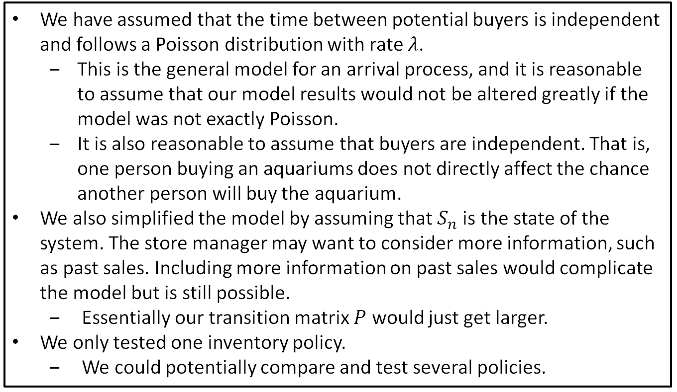
Robustness
We have assumed that the time between potential buyers is independent and follows a Poisson distribution with rate $λ$.
This is the general model for an arrival process, and it is reasonable to assume that our model results would not be altered greatly if the model was not exactly Poisson.
It is also reasonable to assume that buyers are independent. That is, one person buying an aquariums does not directly affect the chance another person will buy the aquarium.
We also simplified the model by assuming that $S_{n}$is the state of the system. The store manager may want to consider more information, such as past sales. Including more information on past sales would complicate the model but is still possible.
Essentially our transition matrix $P$ would just get larger.
We only tested one inventory policy.
We could potentially compare and test several policies.

